Slide 1
CS 598 presentation:
Talk like a Graph: Encoding Graphs for Large Language Models
NetLLM: Adapting Large Language Models for Networking
Kai-Siang Wang, Han-Ting Liang, Gabriella Xue

Slide 2
Talk Like a Graph: Encoding Graphs for Large Language Models
Kai-Siang Wang
Nov 6 2024

Slide 3
Motivation
A study paper on LLMs for graphs
Problems of current LLMs:
Reliance on unstructured text
Difficult to incorporate ‘fresh’ information
Research question:
LLMs for normal texts are good, but what is the performance on graphs?
Notes:
How to use LLM to help to interpret the graph to get the information

Slide 4
Key takeaways
Factors that influence the performance:
Graph encoding
Graph structure
Contextual information of tasks
Design GraphQA
A benchmark for measuring LLM performance

Slide 5
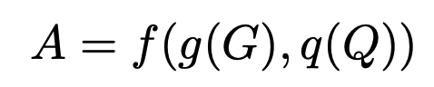
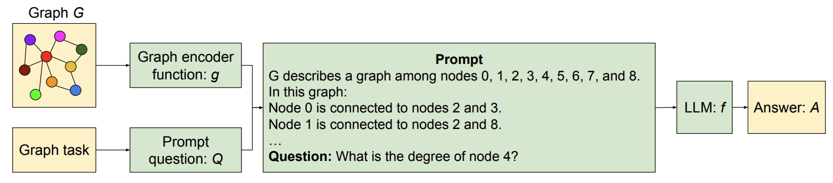
LLMs for Graph: problem definition
Goal: Find the best answer A given G and Q

Slide 6
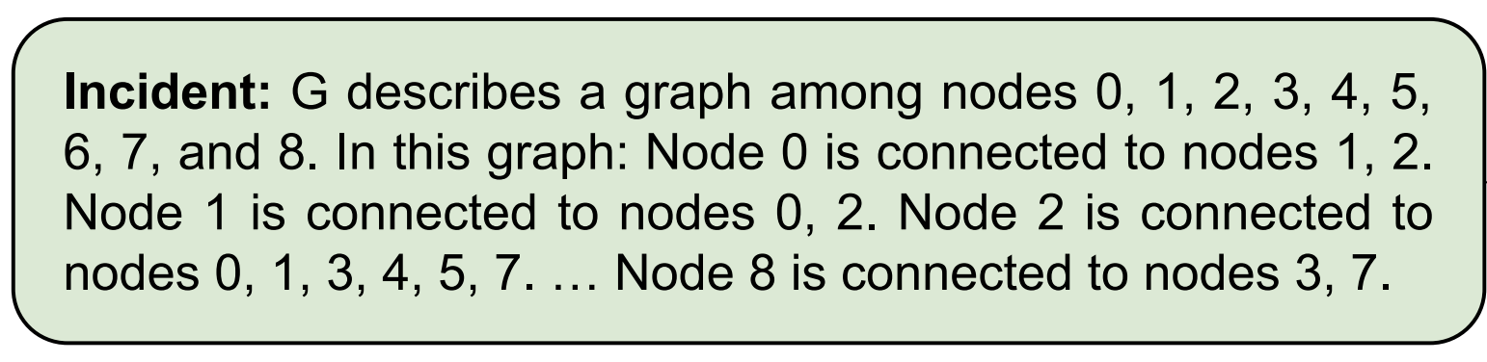
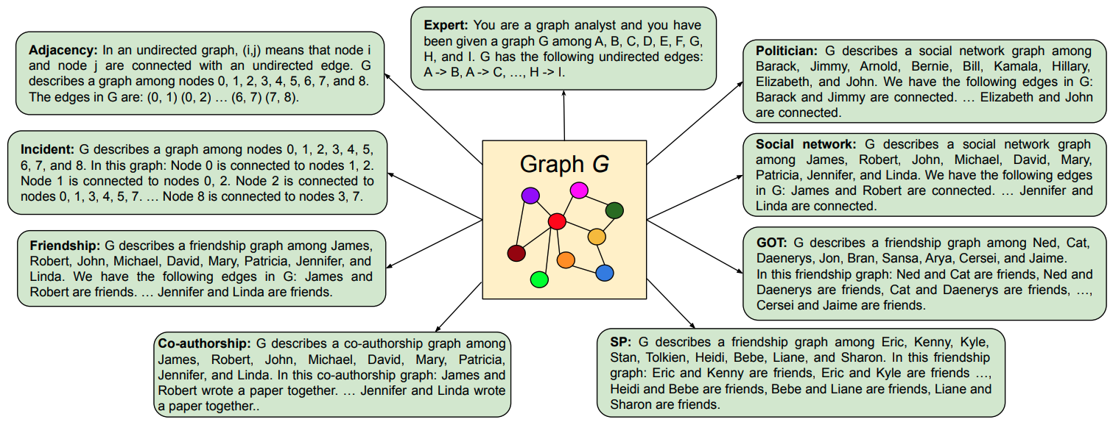
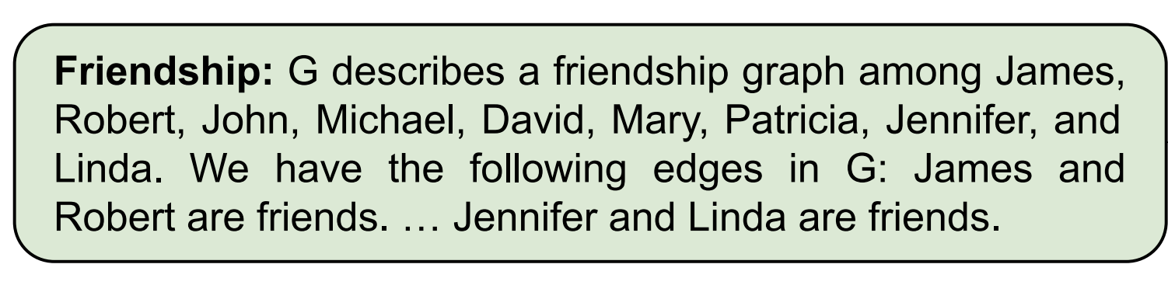
Graph encoding for LLMs

Slide 7
Graph prompting
Multiple heuristics have been proposed:
Zero-shot prompting
Few-shot in-context learning
Chain-of-thought (CoT)
Zero-shot CoT (“Let’s think step by step”)
Bag prompting

Slide 8
Graph encoding for LLMs
3 important findings
LLMs perform poorly on basic graph tasks
The graph encoding function has a significant impact on LLM graph reasoning
Model capacity has a significant effect on graph reasoning capabilities of LLMs

Slide 9
GraphQA
Problem sets:
Edge existence
Node degree
Node count
Edge coun
Connected nodes
Cycle check
Disconnected nodes

Slide 10
Angles taken in consideration
Graph encoding/ graph prompting
Question encoding
The way to ask questions
Multiple relation encoding
Importance of edges
Model capacity
Large model -> better performance
Graph structure
Shape, connectivity

Slide 11
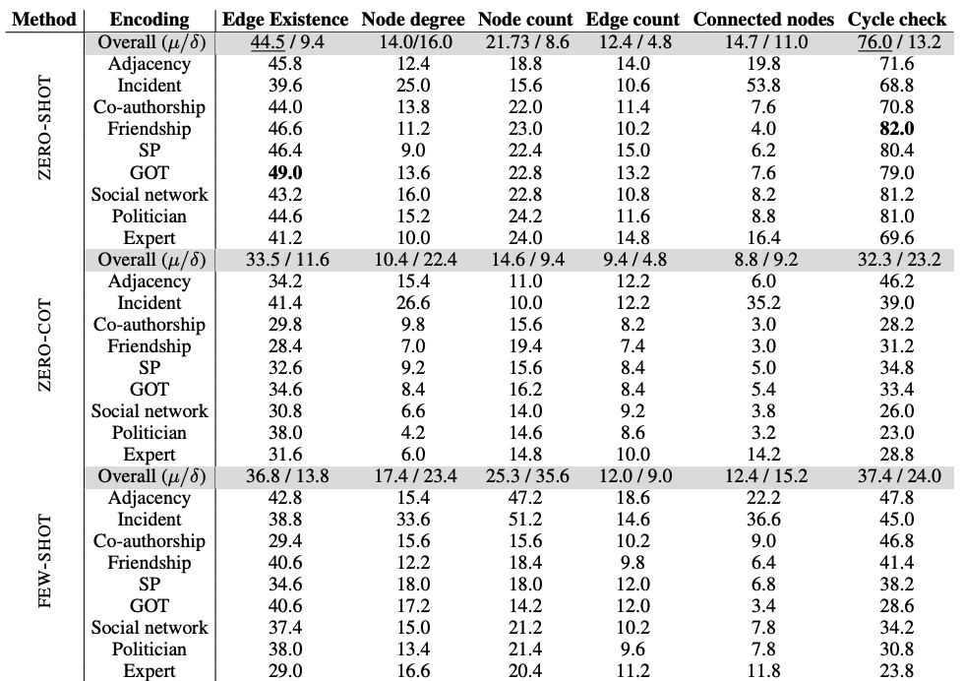
Graph Encoding
Perform poorly on basic graph tasks
Graph encoding functions have large impact

Slide 12
Prompting
Simple prompts works best simple tasks
ZERO-SHOT prompting is sufficient (no need of multi-hop reasoning)
For harder tasks (arithmetic), CoT may help

Slide 13
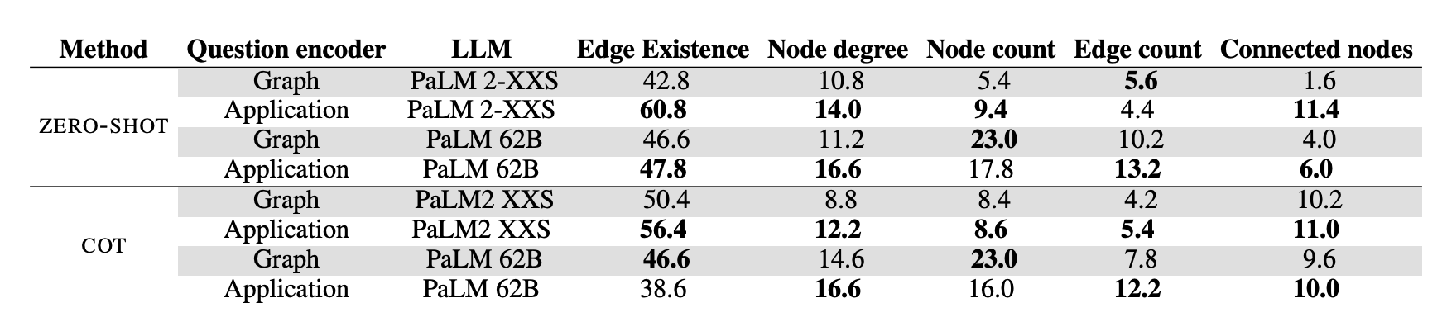
Question Encoder (How to ask questions)
Fix graph encoder (Friendship)
Graph question encoder
“What is the degree of node i?”
Application question encoder
“assessing friendship existence”
Translate a task into more contextually meaningful textual information

Slide 14
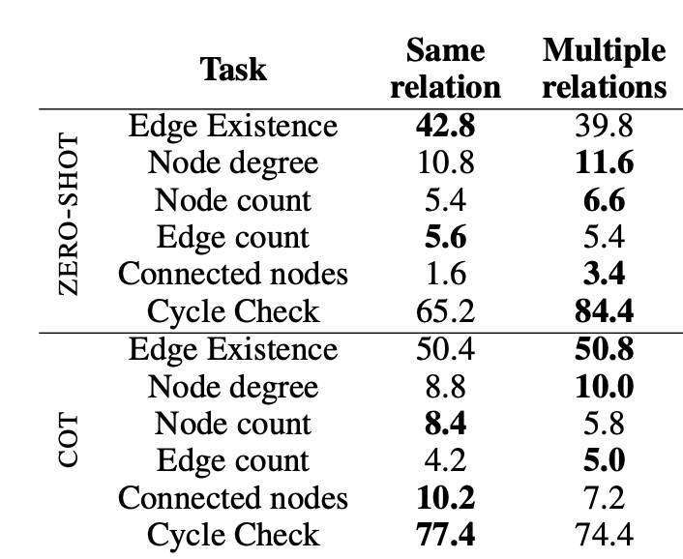
Multiple Relation Encoding (Edge)
Keep using friendship graph
Categorize edges into different types:
friends, colleagues, spouses, …
Diverse set of relations provides the LLM with more textual information

Slide 15
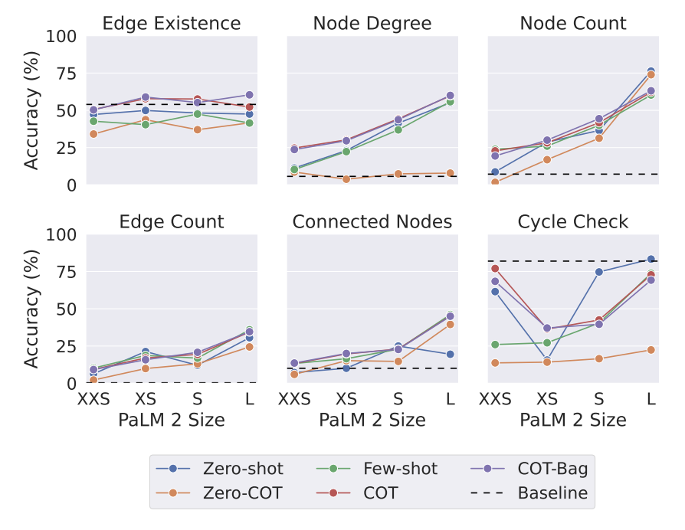
Model Capacity
Model capacity has a significant effect on the graph reasoning ability of an LLM

Slide 16
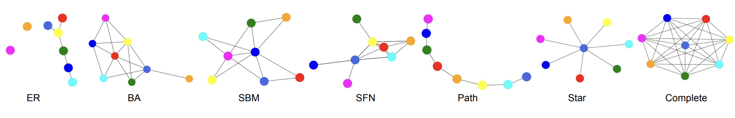
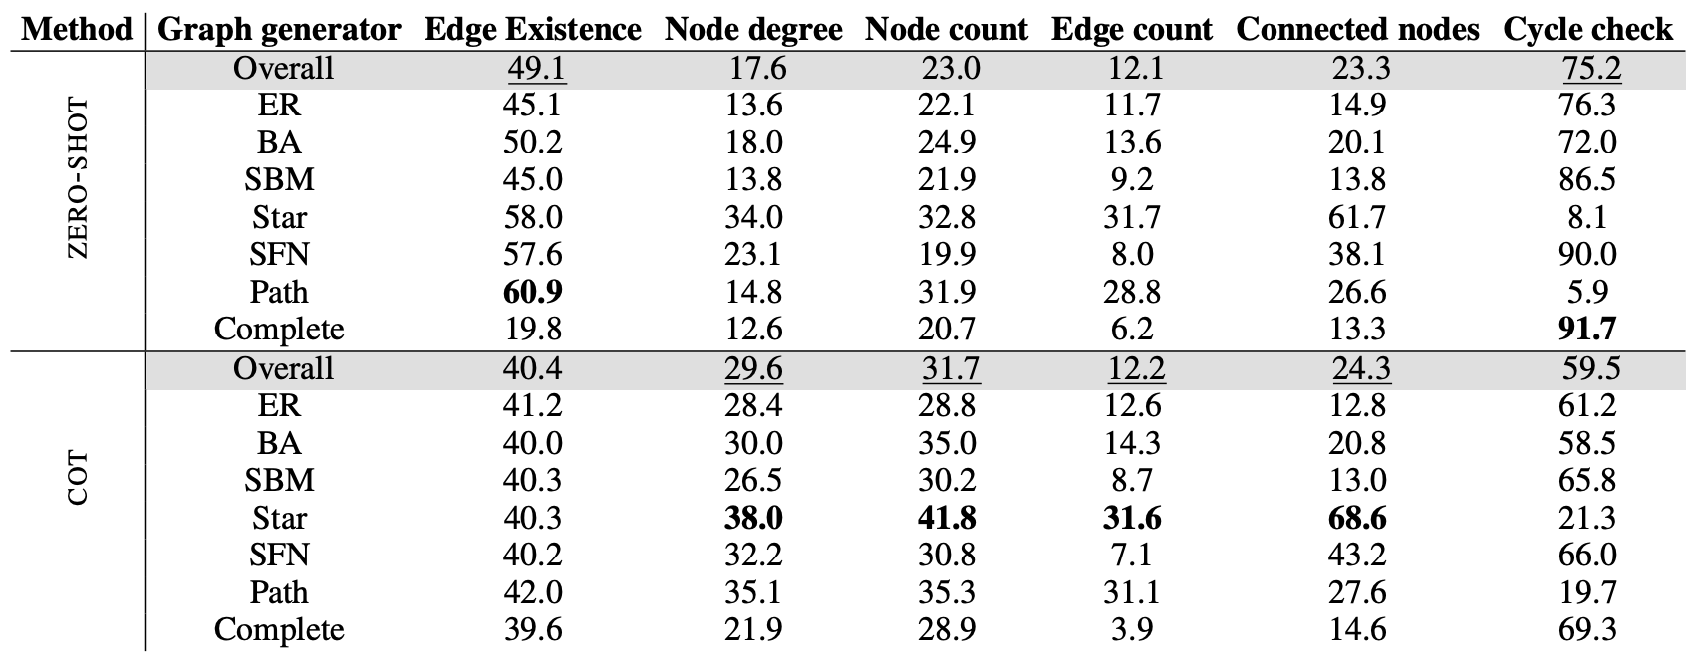
Impact of Graph Structure
Connectivity
Shape of Graph
ZERO-SHOT ~ 0.5%
ZERO-COT, FEW-SHOT, COT, and COT-BAG ~ 0.0%
LLMs lack a global model of a graph
Notes:
This is because the LLM has a strong prior towards graphs having cycles.
By adding few-shot examples some having a cycle and some not, the accuracy of cycle check on path graphs increased from 5.9% to 19.7%
This shows that the LLM has a prior that two nodes in a graph are more likely to be disconnected.

Slide 17
Results wrap up
Encoding functions matter
Different graph shapes confuse LLMs
Provide more contextual text information
Show LLMs’ preferences
Bigger is (usually) better
Better capability of reasoning

Slide 18
Limitations
Focus on basic graph tasks
Lacking study on how to choose optimal encoding/prompting automatically
Scalability
How to encode super large graphs?

Slide 19
Conclusions
Multiple factors have impact on LLM performance
Graph encoding/prompting
Graph structure
Model capacity
It is crucial for LLMs to have enough contextual information

Slide 20
NetLLM: Adapting Large Language Model for Networking
Gabriella Xue and Hanting Liang
Nov 6 2024
Notes:
This work focus on using large language models to solve networking problems

Slide 21
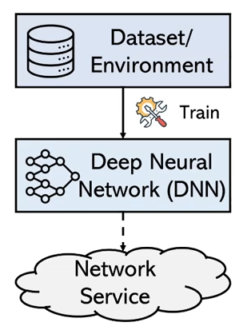
Deep Learning in Networking
DL has been used to solve complex prediction and decision-making tasks in networking
Prediction tasks
Traffic classification (WWW ’22)
Bandwidth prediction (NSDI ’20)
Viewport prediction (TPAMI ’22)
Decision-making tasks
Congestion control (SIGCOMM ’20, ’23)
Adaptive bitrate streaming (SIGCOMM ’17, ’22)
Cloud cluster job scheduling (SIGCOMM ’19)
Notes:
This figure shows the typical pipeline of DL-based algorithms. First, we need to design a deep neural network (DNN) and prepare a dataset representing the network environment to train the model. After training, the DNN model can be used to solve networking problems, allowing us to deploy it for network services. Unfortunately, although this field has been explored by many researchers, it still suffers from several limitations.

Slide 22
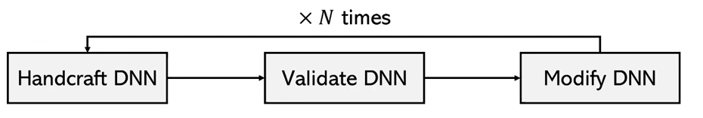
Limitation #1: Labor-intensive model engineering
The success of DL-based algorithms heavily relies on the manual design of black-box DNNs
Trial-and-error design manner
Notes:
Due to the black-box nature of DNN models, the design process is carried out in a trial-and-error manner. We first need to handcraft a DNN model and then validate its performance. If it doesn’t work, we modify the DNN architecture. This process continues until we have a DNN architecture that performs well for the network service. Consequently, the entire process can be labor-intensive.

Slide 23
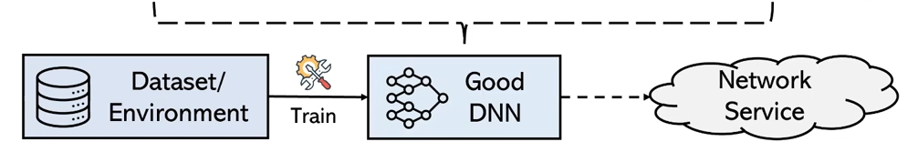
Limitation #1: Labor-intensive model engineering
The success of DL-based algorithms heavily relies on the manual design of black-box DNNs
Trial-and-error design manner
Notes:
Due to the black-box nature of DNN models, the design process is carried out in a trial-and-error manner. We first need to handcraft a DNN model and then validate its performance. If it doesn’t work, we modify the DNN architecture. This process continues until we have a DNN architecture that performs well for the network service. Consequently, the entire process can be labor-intensive.

Slide 24
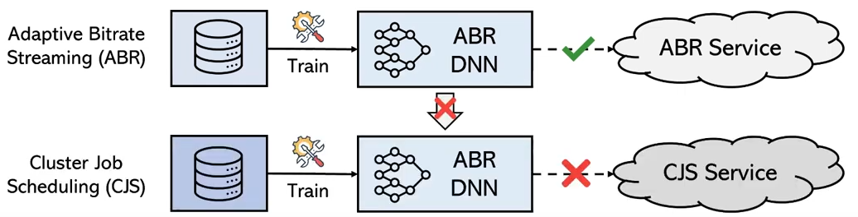
Limitation #1: Labor-intensive model engineering
The success of DL-based algorithms heavily relies on the manual design of black-box DNNs
Trial-and-error design manner
Hard to share across tasks
Notes:
For example, if we have a well-designed DNN model for an adaptive bitrate streaming service, we cannot use the same model for cluster job scheduling. This means that each DNN model is optimized for a specific task, requiring us to design specialized models for different tasks, which increases the model engineering overhead.

Slide 25
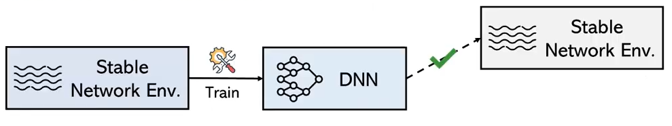
Limitation #2: Poor generalization
DL-based algorithms tend to achieve poor generalization on unseen data distributions or environments

Slide 26
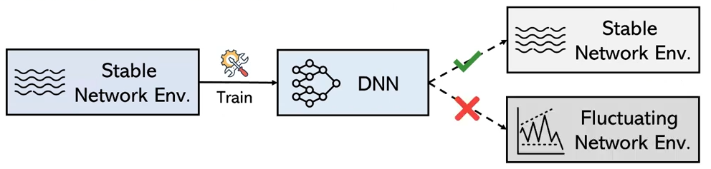
Problem #2: Poor generalization
DL-based algorithms tend to achieve poor generalization on unseen data distributions or environments
Notes:
So how can we do better? How can we reduce model engineering overhead and enhance generalization?

Slide 27
New Opportunities
LLM, e.g., ChatGPT, Falcon and Llama
Absorb extensive knowledge through large-scale pretraining
One model for all tasks in NLP
Applicable to other domains beyond NLP?
Notes:
Utilizing a single generic model for different tasks has been recognized as an effective approach to mitigate the costs of model engineering and to enhance generalization. This is exemplified by recent popular large language models, such as ChatGPT, Falcon, and Llama2, in the field of natural language processing. LLMs are powerful in NLP, but are they applicable to other domains beyond NLP?

Slide 28
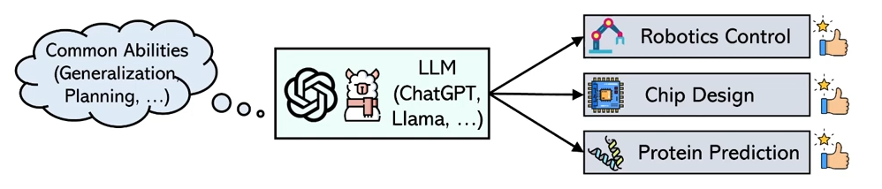
New Opportunities
LLM exhibits some emergent abilities and they are proved to be transferable across domains.
Notes:
…Can we also use LLM in networking?

Slide 29
New Opportunities – LLM for Networking
One model for all
Achieve better performance
Notes:
If we can use LLM in networking, we should 1) no longer need to handcraft specialized DNN models for different networking tasks -> significantly reducing model engineering overhead; 2) with the extensive knowledge of the LLM, we can utilize its powerful capabilities to achieve better performance on each tasks.

Slide 30
New Opportunities – LLM for Networking
One model for all
Achieve better performance
Key question: Can we embrace the era of LLMs and adapt LLMs to solve various networking tasks efficiently and effectively?

Slide 31
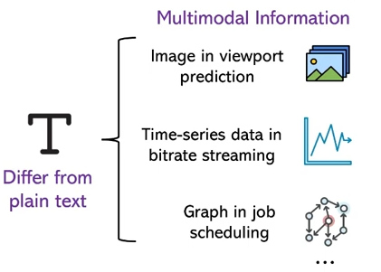
Challenge #1: Large input modality gap
Large input modality gap
Different networking tasks have different input information of diverse modalities
Spanning from time-series network throughputs to DAG data
Notes:
To answer this question, we need to overcome the three challenges.
Most LLMs are designed to accept plain text as inputs. However, different networking… DAG data, which are hard to transform into text prompts.

Slide 32
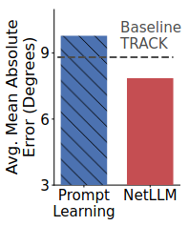
Challenge #1: Large input modality gap
Large input modality gap
Different networking tasks have different input information of diverse modalities
Spanning from time-series network throughputs to DAG data
Transformation can be ineffective even achieves through prompt learning
Notes:
TRACK is SL based DNN

Slide 33
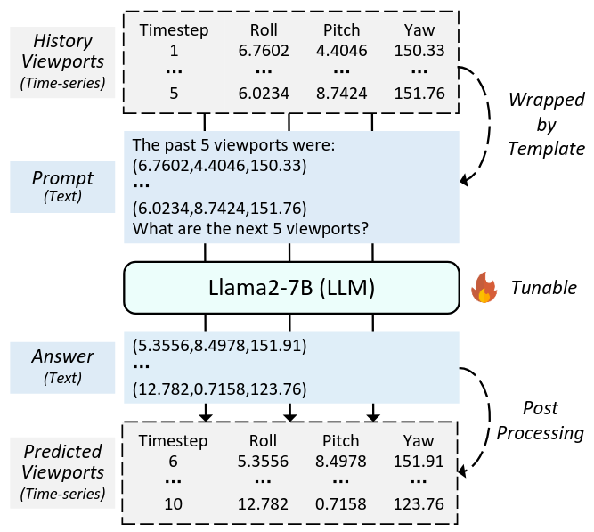
Challenge #2: Inefficiency of answer generation
Large input modality gap
Inefficiency of answer generation
Prone to hallucination due to inherent uncertainty of token prediction
Notes:
Hallucination: answers may seem correct but physically invalid
High generation latency: May fail when need to quickly react to network condition

Slide 34
Challenge #2: Inefficiency of answer generation
Large input modality gap
Inefficiency of answer generation
Prone to hallucination due to inherent uncertainty of token prediction
Notes:
Potential problem: tried on chatgpt, it cannot inteprete message properly

Slide 35
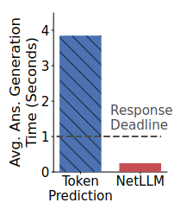
Challenge #2: Inefficiency of answer generation
Large input modality gap
Inefficiency of answer generation
Prone to hallucination due to inherent uncertainty of token prediction
High answer generation latency
Notes:
Due to the sub-word nature of tokens, a single word may span multiple tokens. In consequence, LLMs often require multiple inferences to generate a single answer and thus can fail to quickly adapt to the system changes.
The response deadline for predicting future viewports is one second/

Slide 36
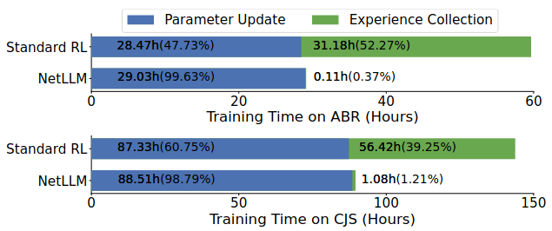
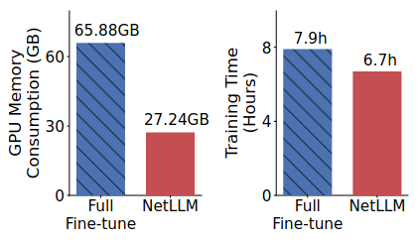
Challenge #3: High adaptation cost
Large input modality gap
Inefficiency of answer generation
High adaptation cost
Network environment require active interaction
Full-parameter fine-tuning requires extensive memory and computation
Notes:
It requires the active interaction between the environment and the LLM to collect experience datasets for training. This process can be very time consuming.
Even worse, to adapt a general-purpose language model to perform well in the specific context of networking tasks, we might need to fully fine-tune the parameters of the LLM. The parameter size for LLM can be very large which results in extensive memory usage and computation time.

Slide 37
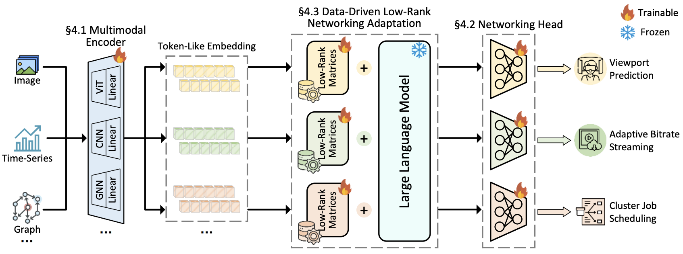
Overview of NetLLM
Notes:
To efficiently solve the aforementioned challenges, this paper proposes NetLLM, an innovative LLM adaptation framework for networking. Let’s take a look at three main building blocks of NetLLM. First part is multimodal encoder, which let LLM understand network information effectively. Second part is Networking head, which let LLM generate answers for networking efficiently. And finally there’s the data-driven low-rank networking adaptation, which is useful for fine-tuning LLM and let LLM learn networking knowledge efficiently

Slide 38
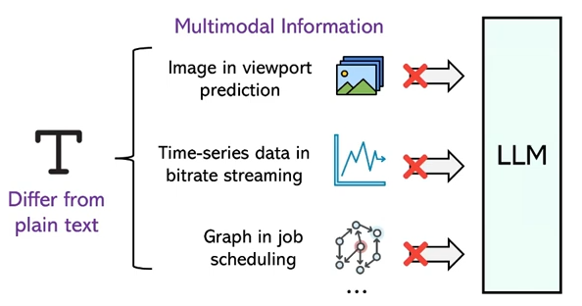
Multimodal Encoder
Challenge 1: How to enable LLM to understand networking information with diverse modality?
Notes:
As we mentioned before, the diverse multimodal information is unable to be processed directly by LLM since it differs from plain text.

Slide 39
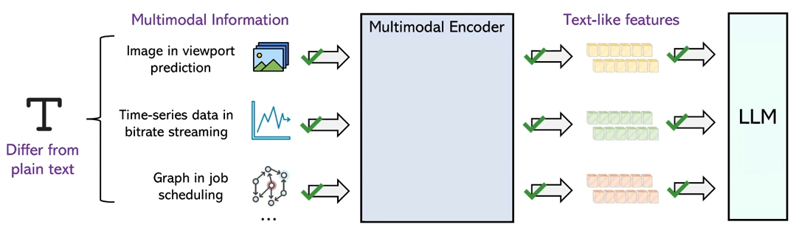
Multimodal Encoder
Challenge 1: How to enable LLM to understand networking information with diverse modality?
Notes:
The key idea of solve this challenge is to project data into the same feature space as texts, so that LLM can understand the multimodal information.

Slide 40
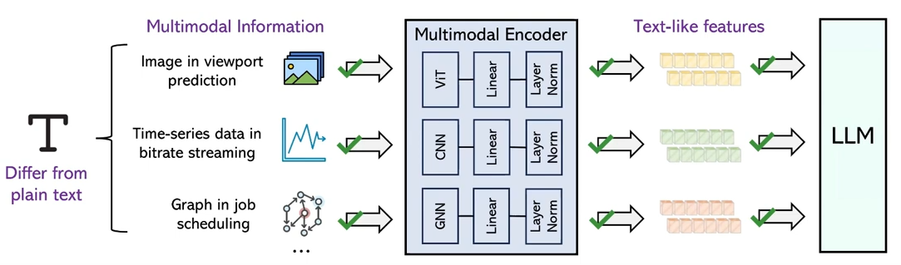
Multimodal Encoder
Challenge 1: How to enable LLM to understand networking information with diverse modality?
Tradeoffs?
Multimodal encoder: Project data into the same feature space as texts.
Notes:
Inside this module, it first integrates the existing feature encoders to inject features from the raw input data, such as ViT for images, 1D-CNN for time-series and sequence data, GNN for graphs. The output from each encoder is a feature vector that represents the specific modality of input data in a high-dimensional space.
Then it uses a set of trainable linear layers to project the features extracted by different encoders. These layers transform the original feature vectors into a new vector space with a consistent dimension.
Finally they add a layer normalization to build the multimodal features to improve the training stability. It helps ensure that each layer receives inputs that are roughly on the same scale, improving convergence.
One potential drawback, not really discussed in the paper but we feel might metter is that, although employing different feature encoders improve model accuracy and generalization across tasks, but the increased model size can potentially resulting in longer training time, higher computational cost and overhead in data alignment. It would be better if these tradeoffs can also be mentioned in the paper.

Slide 41
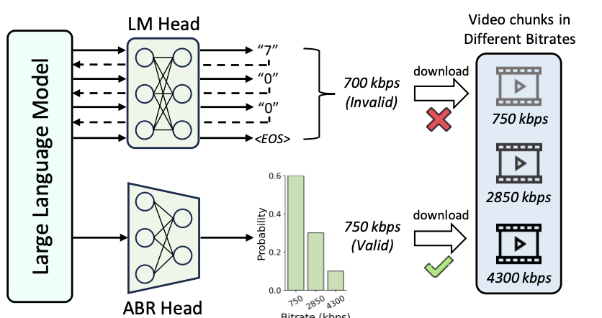
Networking Head
Challenge 2: How to enable LLM to generate answers for networking efficiently?
Notes:
LLM generates answers by token prediction with a LM head. The generated token is repeatedly fed to LLM, and LLM iteratively refines each token’s representation. It takes multiple inferences for LM head to result an answer which results in high latency. Also due to the uncertainty of token generation, the answer can be invalid. As you can see, the generated bitrate does not match any encoded video chunks.

Slide 42
Networking Head
Challenge 2: How to enable LLM to generate answers for networking efficiently?
Networking head: a linear output layer to generate task-specific answers directly.
Notes:
The key idea to address this challenge is to replace the language modeling head with a customized task specific networking head. The network head is in fact a linear output layer to directly generate answers based on the LLM output features. It constrains the answer generation into the valid range of possible answers.
As an example, this ABR head is specially designed to predict the probability distribution of bitrates, the bitrate with the maximum probability is chosen as the answer. Since the outputs of networking head are limited to the discrete set of candidate bitrates, the generated answers are guaranteed to be always valid.

Slide 43
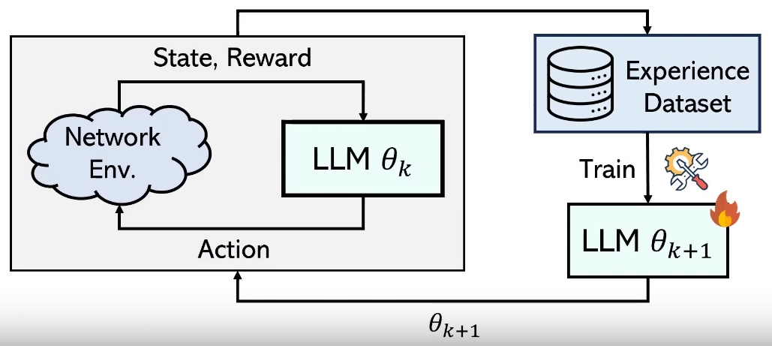
DD-LRNA
Challenge 3: How to fine-tune the LLM to learn networking knowledge efficiently?

Slide 44
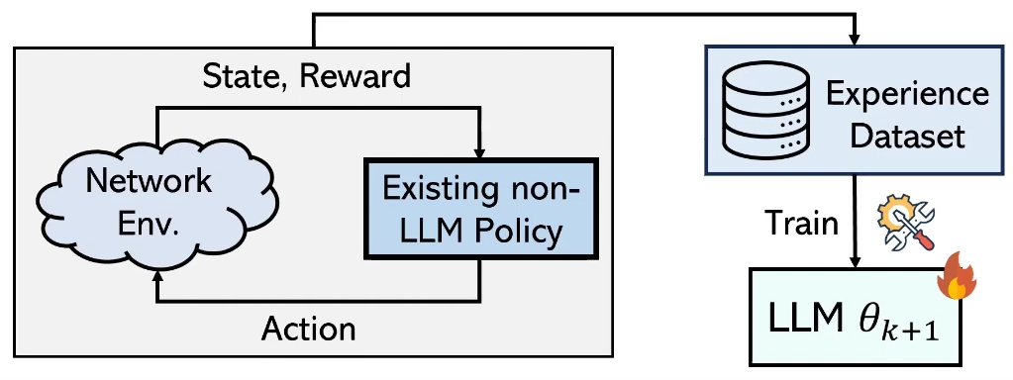
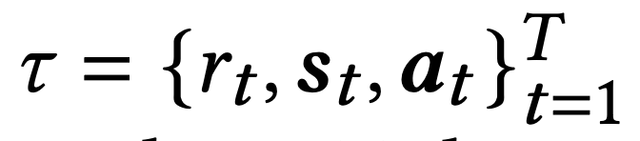
DD-LRNA
Challenge 3: How to fine-tune the LLM to learn networking knowledge efficiently?
DD-LRNA: 1) Remove interactions between LLM and environments based on data-driven RL
Notes:
What does it mean is, it collects the experience dataset with any existing (non-LLM) networking algorithms, and exploit this dataset to fine-tune the LLM for reward optimization. For example, given a RL-based networking task, it first employs an existing policy, which collects an experience dataset which consists of experience trajectories.
Each trajectory is composed of rewards r, states s and actions a, where T denotes the episode length.
Assume it effectively captures a broad range of state-action-reward interactions in networking scenarios, this approach allows the dataset to be collected only once and used throughout the entire training process, which reduces the training time for more than 30%.

Slide 45
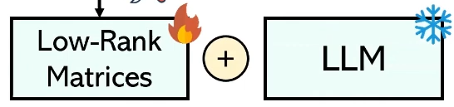
DD-LRNA
Challenge 3: How to fine-tune the LLM to learn networking knowledge efficiently?
DD-LRNA: 2) Insert low-rank matrices to reduce the number of trainable parameters
Notes:
The insight behind is to constraint the parameter update to a limited amount, which is using a similar idea as previous LoRa paper we discussed in class.

Slide 46
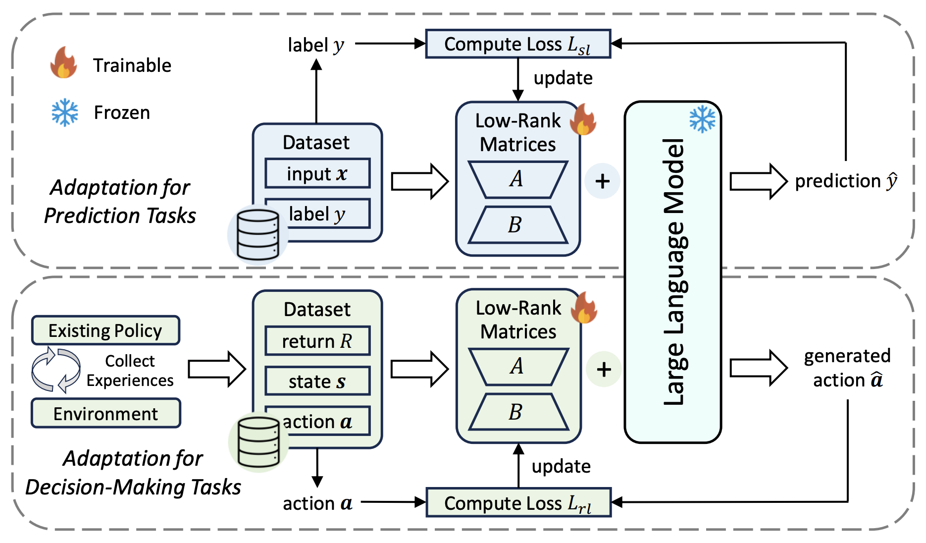
DD-LRNA
Notes:
Put both insights together, DD-LRNA scheme freezes the parameters of LLM and allocate different trainable low-ranke matrices for each task. These matrices are then fine-tuned over a dataset to acquire domain-specific knowledge.

Slide 47
Evaluation
Simulation setup
Llama2 as the foundation LLM
Networking tasks: VP, ABR, and CJS
Baselines
Learning-based algorithms
Rule-based algorithms
Metrics
MAE for VP, QoE for ABR, JCT for CJS
Hardware settings:
Two NVIDIA 40GB A100 GPUs
Notes:
QoE is calculated as the combination of bitrate, rebuffering time and bitrate changes

Slide 48
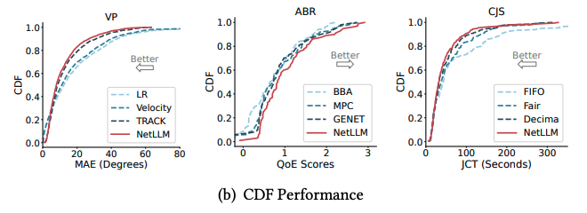
General Evaluation
Learning-based algorithms outperform traditional rule-based algorithms
Due to their larger parameter sizes and large-scale pre-training. LLMs are more powerful in function approximation, pattern mining, and long-term planning.
They help reduce the engineering overhead.
Notes:
Uses the same LLM to solve various networking tasks

Slide 49
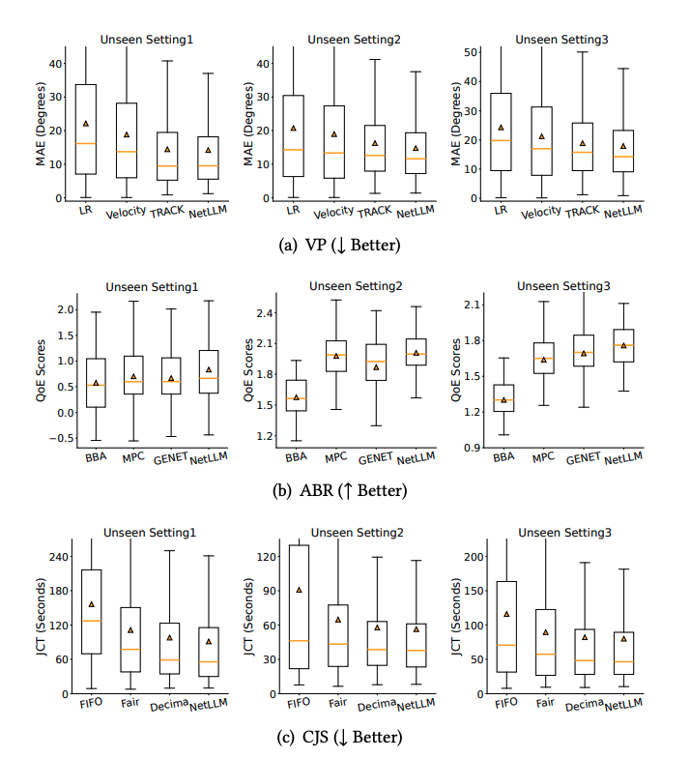
Generalization
NetLLM can efficiently utilize the extensive knowledge of the LLM to achieve stronger generalization.
Notes:
GENET has around 5% lower QoE on unseen setting because it fails to optimize video bitrates and adapt to the dynamic fluctuations of bandwidth, therefore, it may select wrong bitrates with current bandwidth resources

Slide 50
Generalization
Learning-based algorithms do not always outperform conventional rule-based algorithms.
Notes:
GENET has around 5% lower QoE on unseen setting because it fails to optimize video bitrates and adapt to the dynamic fluctuations of bandwidth, therefore, it may select wrong bitrates with current bandwidth resources

Slide 51
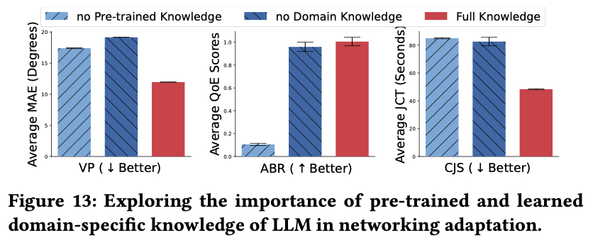
Deep Dive
LLMs can be adapted for networking due to the pre-trained and domain knowledge.
Notes:
To understand why LLMs can be adapted for networking, the experiment is straightforward. The authors disable the pre-trained and domain knowledge and found that the absence of these knowledge results in performance degradation

Slide 52
More experiments
Impacts of different types of LLMs
All the adapted LLMs the state of the arts on both tasks, which confirms the compatibility of NetLLM.
Impacts of different sizes of LLMs
In practice, LLMs with parameter sizes greater than 1B are suitable for networking adaptation, while those smaller than 1B may not be the optimal choices for adaptation.
Computation overhead
The computation overhead can be reduced by utilizing the advanced model compression techniques or employing smaller LLMs which also achieves superior performance.
Notes:
Adapted NetLLM on different LLMs
OPT performs significantly worse than all baselines due to the limited common knowledge to generalize across tasks

Slide 53
More experiments
Impacts of different types of LLMs
All the adapted LLMs the state of the arts on both tasks, which confirms the compatibility of NetLLM.
Impacts of different sizes of LLMs
In practice, LLMs with parameter sizes greater than 1B are suitable for networking adaptation, while those smaller than 1B may not be the optimal choices for adaptation.
Computation overhead
The computation overhead can be reduced by utilizing the advanced model compression techniques or employing smaller LLMs which also achieves superior performance
Notes:
Adapted NetLLm on diffdernet LLMs
OPT performs significantly worse than all baselines due to the limited common knowledge to generalize across tasks

Slide 54
More experiments
Impacts of different types of LLMs
All the adapted LLMs the state of the arts on both tasks, which confirms the compatibility of NetLLM.
Impacts of different sizes of LLMs
In practice, LLMs with parameter sizes greater than 1B are suitable for networking adaptation, while those smaller than 1B may not be the optimal choices for adaptation.
Computation overhead
The computation overhead can be reduced by utilizing the advanced model compression techniques or employing smaller LLMs which also achieves superior performance
Notes:
Adapted NetLLm on diffdernet LLMs
OPT performs significantly worse than all baselines due to the limited common knowledge to generalize across tasks

Slide 55
Discussion
What considerations are needed when adapting LLMs for specific networking tasks using NetLLM?
The creation of a new networking head
The selection of a modality-specific feature encoder
How does NetLLM compare to retrieval-augmented generation (RAG)?
Constructing an external knowledge base for RAG is challenging in the field of networking due to the abstract and implicit nature of networking knowledge.

Slide 56
Conclusion
The paper proposed NetLLM, the first framework that efficiently adapts LLMs for different networking tasks.
NetLLM enables the effective utilization of a single LLM to achieve superior performance and generalization in multiple networking tasks.
Overall, the paper provides a good picture of how can we benefits from LLM to deal with various networking tasks.

